Slide 1
Project Management
CT050-3-3-PRMGT
01: An Introduction to Project, Program, and Portfolio Management

Slide 2
Learning Objectives
Understand the growing need for better project, program, and portfolio management
Explain what a project is, provide examples of projects, list various attributes of projects, and describe project constraints
Describe project management and discuss key elements of the project management framework, including project stakeholders, the project management knowledge areas, common tools and techniques, project success factors, and project benefits measurement

Slide 3
Learning Objectives (continued)
Discuss the relationship between project, program, and portfolio management and their contributions to enterprise success
Describe the project management profession, including the role of project managers and suggested skills for project management careers.

Slide 4
What Is a Project?
A project is “a temporary endeavor undertaken to create a unique product, service, or result”*
a piece of planned work or an activity that is finished over a period of time and intended to achieve a particular purpose
Operations is work done to sustain the business
Projects end when their objectives have been reached, or the project has been terminated

Slide 5
Project management is all about getting things done.
Its about knowing exactly what you want to achieve, how you want to achieve it and how long will it take.
Its about ensuring everyone involved shares and understand those aims before the first steps are taken and they continues to as the en of the project whatever it is.
Successful projects don’t just happen. They need to be done.

Slide 6
Examples of Projects
A young couple hires a firm to design and build them a new house
A medical technology firm develops a device that connects to smart phones
A group of musicians starts a company to help children develop their musical talents
A pharmaceutical company launches a new drug
A television network develops a system to allow viewers to vote for contestants and provide other feedback on programs
The automobile industry develops standards for electric cars
A government group develops a program to track child immunizations

Slide 7
Project Attributes
A project:
Has a unique purpose
Is temporary
Drives change and enables value creation
Is developed using progressive elaboration (continuous improvement) or in an iterative (repetitive) fashion
Requires resources, often from various areas
Should have a primary customer or sponsor
The project sponsor usually provides the direction and funding for the project
Involves uncertainty

Slide 8
Project Constraints
Every project is constrained in different ways. Some project managers focus on the triple constraint (meeting scope, time, and cost goals)
Scope: What work will be done as part of the project? What unique product, service, or result does the customer or sponsor expect from the project?
Time: How long should it take to complete the project? What is the timeline?
Cost: What should it cost to complete the project? What is the project’s budget? What resources are needed?
Other constraints include quality, risk, and resources

Slide 9
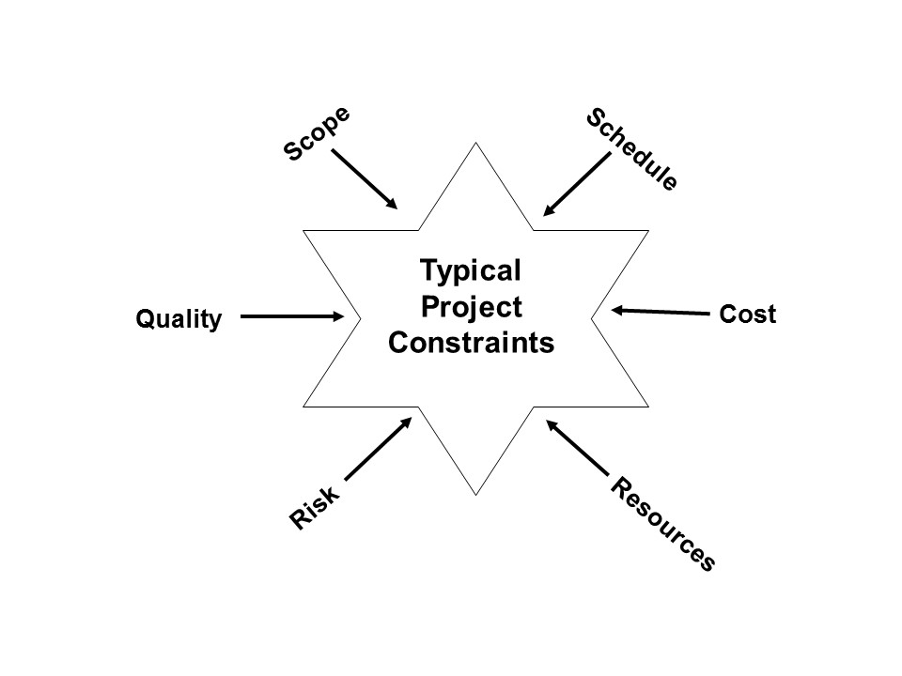
Figure 1-2. Typical Project Constraints

Slide 10
What is Project Management?
Project management is “the application of knowledge, skills, tools and techniques to project activities to meet project requirements.”*
Project management is the process of leading the work of a team to achieve all project goals within the given constraints.

Slide 11
Advantages of Using Formal Project Management
Better control of financial, physical, and human resources
Improved customer relations
Shorter development times
Lower costs
Higher quality and increased reliability
Higher profit margins
Improved productivity
Better internal coordination
Higher worker morale

Slide 12
Project Stakeholders
Stakeholders are the people involved in or affected by project activities
Stakeholders include:
The project sponsor
The project manager
The project team
Support staff
Customers
Suppliers
Opponents to the project

Slide 13
Project Management Knowledge Areas
Project integration (coordination) management is an overarching function that coordinates the work of all other knowledge areas. Coordination means the process of integrating, combining and organizing all the available resources, working together so as to achieve organizational objectives. It affects and is affected by all of the other knowledge areas.
Project scope management involves working with all appropriate stakeholders to define, gain written agreement for, and manage all the work required to complete the project successfully.
Project time management includes estimating how long it will take to complete the work, developing an acceptable project schedule given cost-effective use of available resources, and ensuring timely completion of the project.
Project cost management consists of preparing and managing the budget for the project.
Project quality(distinctive feature that satisfy the given needs) management ensures that the project will satisfy the stated or implied needs for which it was undertaken.

Slide 14
Project Management Knowledge Areas (continued)
Project resource management is concerned with making effective use of the people and physical resources needed for the project.
Project communications management involves generating, collecting, disseminating, and storing project information.
Project risk management includes identifying, analyzing, and responding to risks related to the project.
Project procurement management involves acquiring or procuring goods and services for a project from outside the performing organization.
Project stakeholder management focuses on identifying project stakeholders, understanding their needs and expectations, and engaging them appropriately throughout the project.

Slide 15
Project Management Tools and Techniques
Project management tools and techniques assist project managers and their teams in various aspects of project management.
Note that a tool or technique is more than just a software package.
Specific tools and techniques include:
WBS
Gantt charts, network diagrams, critical path analyses (time)
Net present value, cost estimates, and earned value management (cost)

Slide 16
Project Success
There are different ways to define project success:
The project met scope, time, and cost goals.
The project satisfied the customer/sponsor.
The project produced the desired results.

Slide 17
Program and Projects
A program refers to multiple projects which are managed and delivered as a single package.
A program manager is therefore tasked with overseeing all the projects comprising the program – to ensure it achieves its outcomes.

Slide 18
Programs and Megaprojects
A program is “a group of related projects, subsidiary programs, and program activities managed in a coordinated manner to obtain benefits not available from managing them individually.”*
A megaproject is a very large project that typically costs over US $1 billion, affects over one million people, and lasts several years.
*Project Management Institute, Inc., A Guide to the Project Management Body of Knowledge (PMBOK® Guide – Sixth Edition) (2017).

Slide 19
Structure: The components of a project are specific and exact.
The scope and goals of a project are well-defined – while programs are typically less clear-cut.
Because a program covers multiple projects – a program team tends to be larger as it also incorporates the project managers and their project team members.

Slide 20
A project represents a single, focused endeavor.
A program is a collection of projects – together all the projects form a connected package of work. The different projects complement each other to assist the program in achieving its overall objectives.

Slide 21
Length: While some projects take several years – the typical project will not take very long to complete.
Programs often take a very long time to complete as they intend to deliver more. It’s therefore common for programs to be organised into phases or tranches.
A particularly long project may also be organised into multiple phases – but this is less common.

Slide 22
Benefits: Projects focus on achieving tangible outputs, i.e. what you gain upon completing the project.
Programs focus on outcomes – which are often not tangible. The benefits provided by a program depend on the collective benefits of its projects.

Slide 23
Project Portfolio Management
Portfolio management: Investment management
Project portfolio management (PPM) refers to a process used by project managers and project management organizations (PMOs) to analyze the potential return on undertaking a project. By organizing and consolidating every piece of data regarding proposed and current projects, project portfolio managers provide forecasting and business analysis for companies looking to invest in new projects.
The objectives of PPM are to determine the optimal resource mix and to schedule activities to best achieve an organization’s operational and financial goals, while honoring constraints imposed by customers, strategic objectives, or external real-world factors.

Slide 24
Project and Program Management Compared to Project Portfolio Management
Project and program management address questions like:
Are we carrying out projects well?
Are projects on time and budget?
Do project stakeholders know what they should be doing?
Portfolio management addresses questions like:
Are we working on the right projects?
Are we investing in the right areas?
Do we have the right resources to be competitive?

Slide 25
Figure 1-6. Organizational project management framework (parts of figure)
 | Projects | Programs | Portfolios
Definition | A project is a temporary endeavor undertaken to create a unique product, service, or result. | A program is a group of related projects, subsidiary programs and program activities that are managed in a coordinated way to obtain benefits not available from managing them individually. | A portfolio is a collection of projects, programs, subsidiary portfolios, and operations managed as a group to achieve strategic objectives.
Management | Project managers manage the project team to meet the project objectives. | Programs are managed by program managers who ensure that program benefits are delivered as expected, by coordinating the activities of a program’s components. | Portfolio managers may manage or coordinate portfolio management staff, or program and project staff that may have reporting responsibilities into the aggregate portfolio.
Monitoring | Project managers monitor and control the work of producing the products, services, or results that the project was undertaken to produce | Program managers monitor the progress of program components to ensure the overall goals, schedules, budget, and benefits of the program will be met. | Portfolio managers monitor strategic changes and aggregate resource allocation, performance results, and risk of the portfolio.
Success | Success is measured by product and project quality, timeliness, budget compliance, and degree of customer satisfaction. | A program’s success is measured by the program’s ability to deliver its intended benefits to an organization, and by the program’ efficiency and effectiveness in delivering those benefits. | Success is measured in terms of the aggregate investment performance and benefit realization of the portfolio.
Source: Project Management Institute, Inc., A Guide to the Project Management Body of Knowledge (PMBOK® Guide) – Sixth Edition (2017).

Slide 26
Suggested Skills for Project Managers
Knowledge of the following:
All ten project management knowledge areas
The application area ( industry, market, etc.)
The project environment (politics, culture, change management, etc.)
General management (financial management, strategic planning, etc.)
Human relations (leadership, motivation, negotiations, etc.)

Slide 27
PM Talent Triangle
Technical project management skills: Understanding the knowledge areas, process groups, and project management tools and techniques fall into this category.
Strategic and business management skills: Topics include strategic planning, financial management, accounting, marketing, and other topics.
Leadership skills: Providing vision and inspiration to people.

Slide 28
Additional Skills for Program and Portfolio Managers
Program managers normally have experience as project managers. They often rely on their past experience, strong business knowledge, leadership capability, and communication skills to manage programs
Portfolio managers must have strong financial and analytical skills and understand how projects and programs can contribute to meeting strategic goals

Slide 29
Summary of Main Teaching Points
A project is a temporary endeavor undertaken to create a unique product, service, or result
Project management is the application of knowledge, skills, tools, and techniques to project activities to meet project requirements
A program is a group of related projects, subsidiary programs, and program activities managed in a coordinated manner to obtain benefits not available from managing them individually
Project portfolio management involves organizing and managing projects and programs as a portfolio of investments that contribute to the entire enterprise’s success
The project management profession continues to grow and mature, and demand for project manager is high

Slide 30
Question and Answer Session
Q & A

Slide 31
What we will cover next
02 Introduction – Aligning Projects with Business Strategy

